Slide 1

MOLECULAR GENETICS LABORATORY BT344 Experiment (3)
Hardy-Weinberg Equilibrium
Population Genetics

Slide 2
What Is Hardy-Weinberg Equilibrium?
The Hardy-Weinberg Principle is a way to measure if populations are evolving or not. It is a way to compare allele frequencies in a population over time. There are two equations that can be used if a population is in Hardy-Weinberg equilibrium.
It states that allele frequencies & genotype frequencies in a population remain constant through generations if?

Slide 3
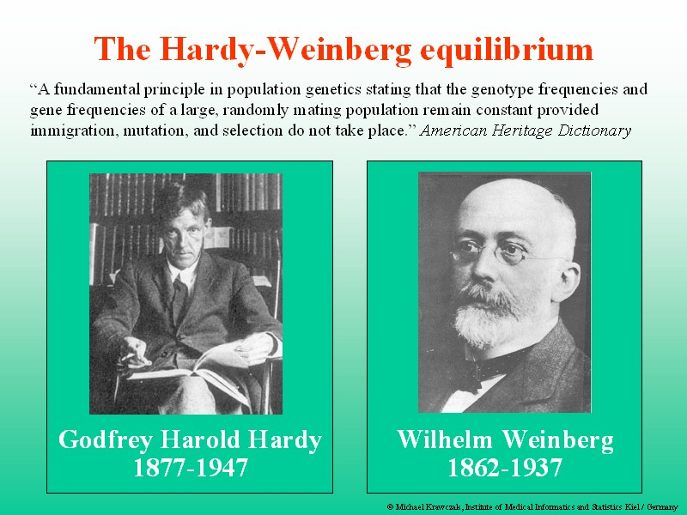

Slide 4
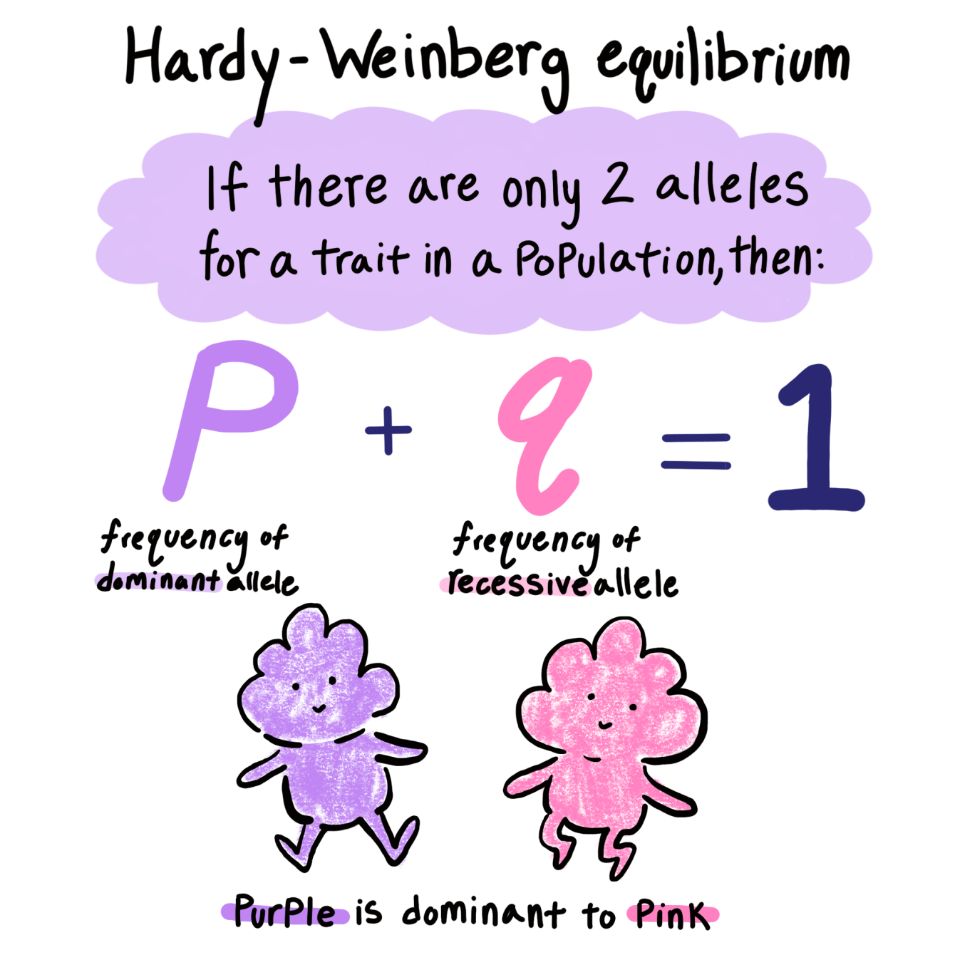

Slide 5
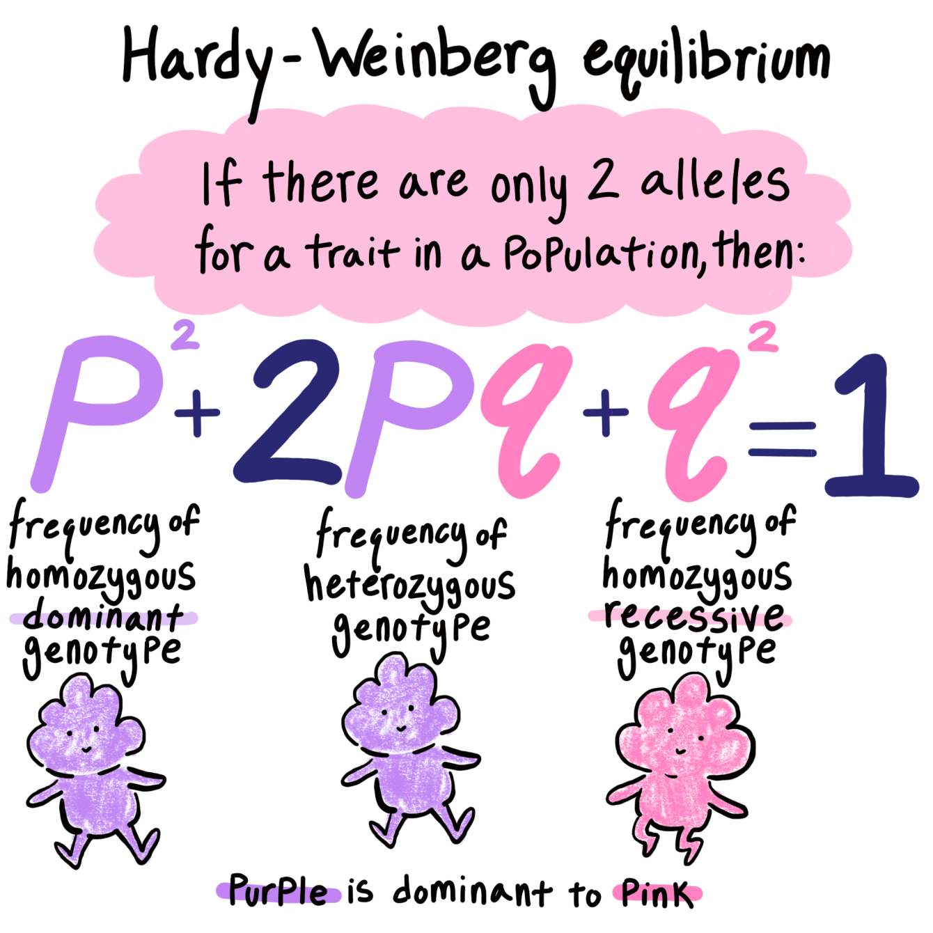

Slide 6
Hardy-Weinberg assumptions
There are also five assumptions about the population:
Random mating (that is, no sexual selection)
Large or infinite population (no genetic drift)
No mutation
No migration
No natural selection
These five conditions must be met for a population to be in Hardy-Weinberg equilibrium.

Slide 7

Hardy-Weinberg equilibrium describes populations that are not evolving.
Real populations rarely meet all five conditions.
Real population data is compared to a model.
Models are used to studying how populations evolve.

Slide 8
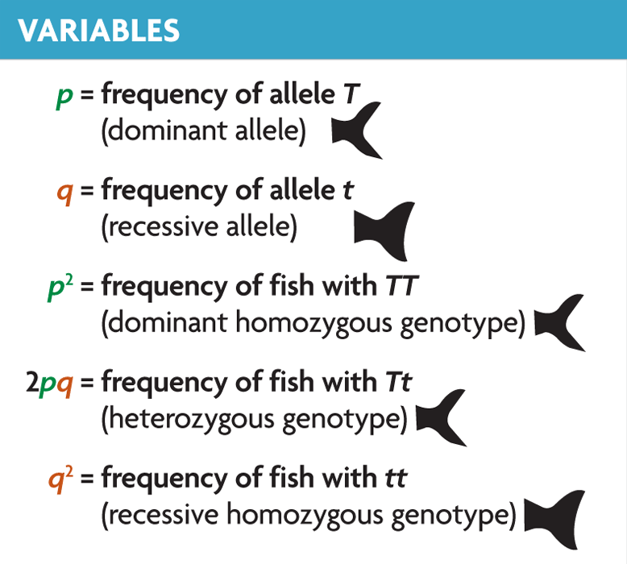
The Hardy-Weinberg equation is used to predict genotype frequencies in a population.
Predicted genotype frequencies are compared with actual frequencies.
used for traits in simple dominant-recessive systems
must know frequency of recessive homozygotes
p² + 2pq + q² = 1

Slide 9
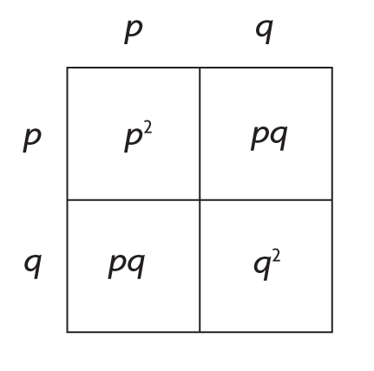
"The Hardy-Weinberg equation is based on Mendelian genetics. It is derived from a simple Punnett square in which p is the frequency of the dominant allele and q is the frequency of the recessive allele."

Slide 10
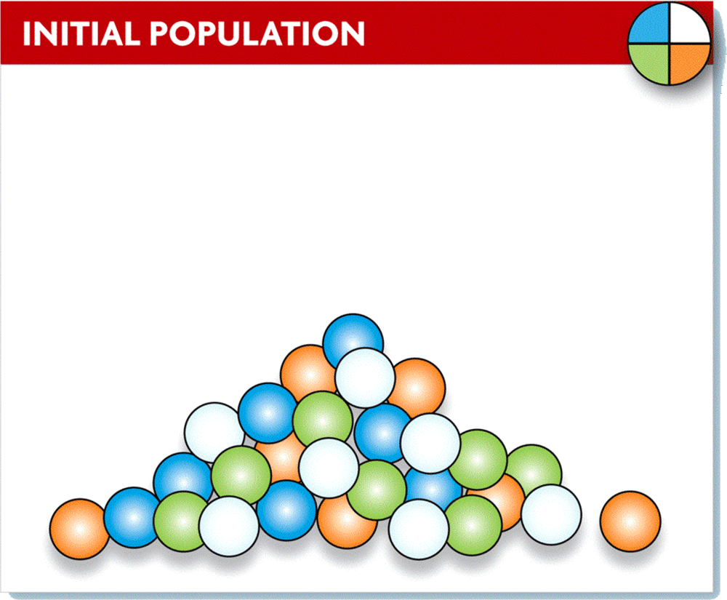
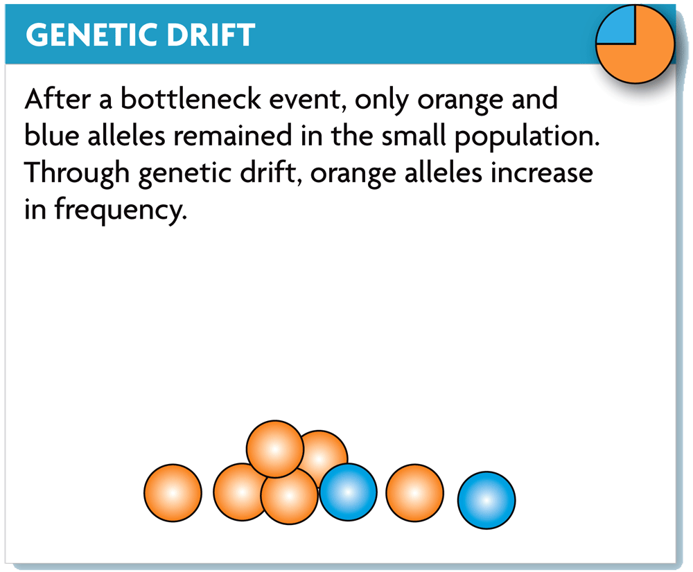
Genetic drift changes allele frequencies due to chance alone.

Slide 11
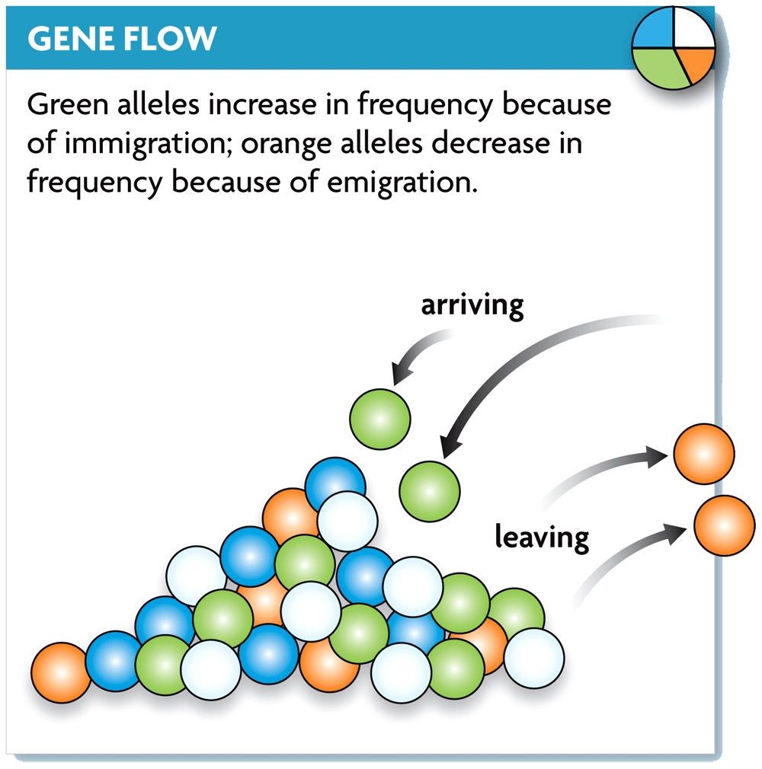
Gene flow moves alleles from one population to another.

Slide 12
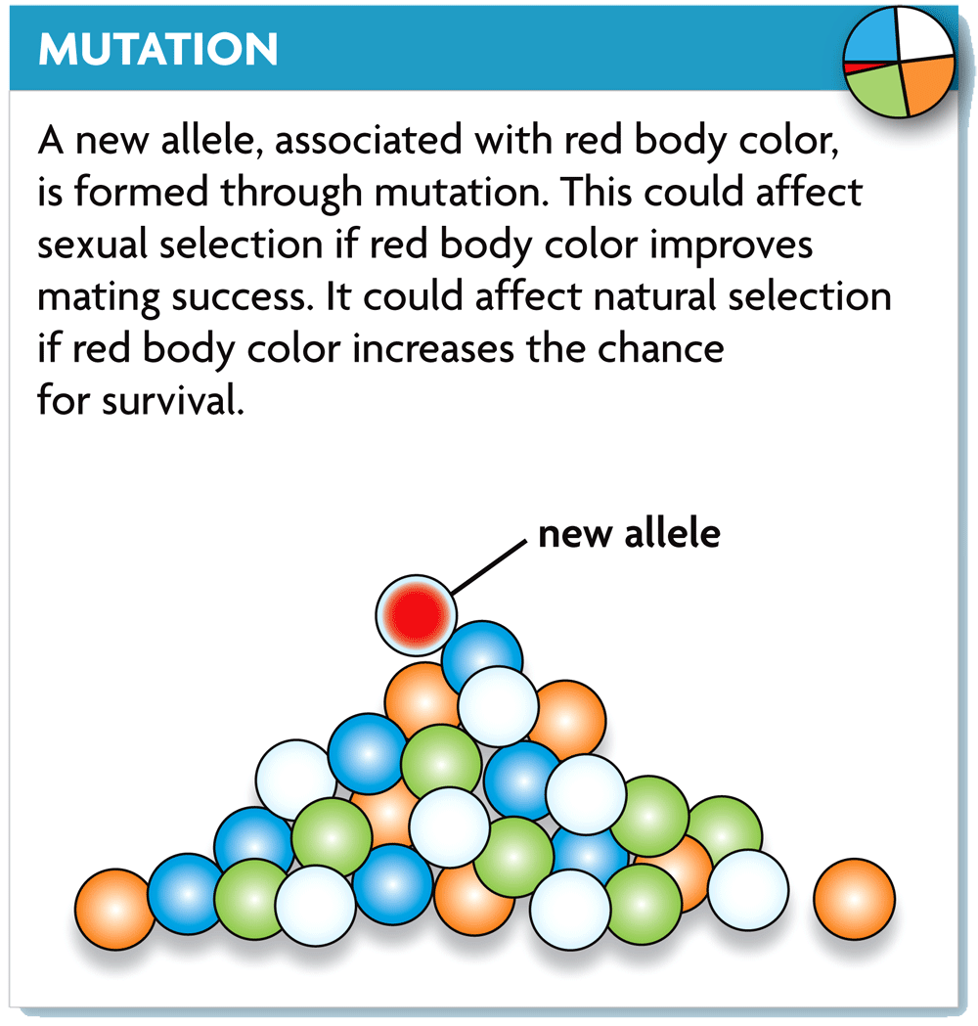
Mutations produce the genetic variation needed for evolution.

Slide 13
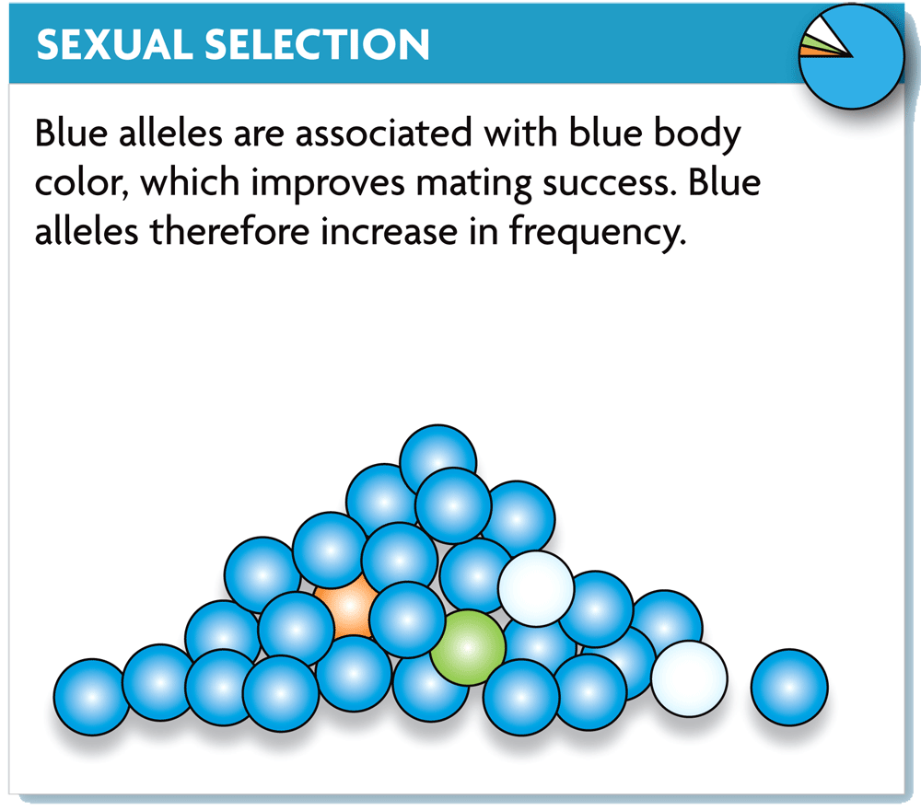
Sexual selection selects for traits that improve mating success.

Slide 14
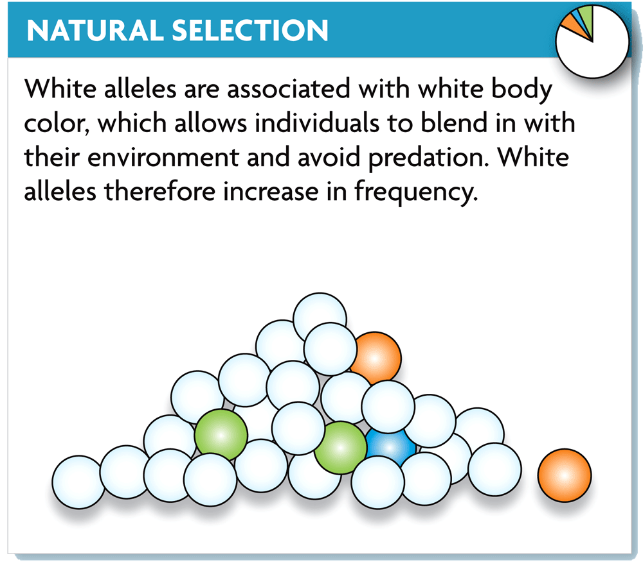
Natural selection selects for traits advantageous for survival.

Slide 15
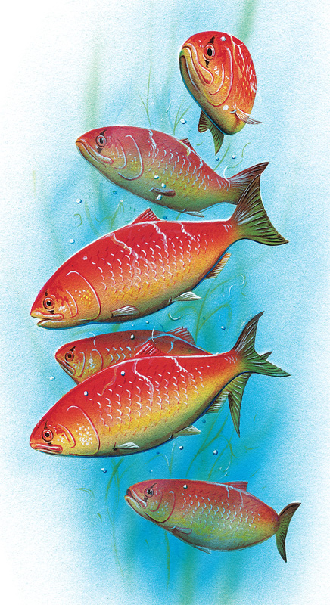
In nature, populations evolve.
expected in all populations most of the time
respond to changing environments

Slide 16
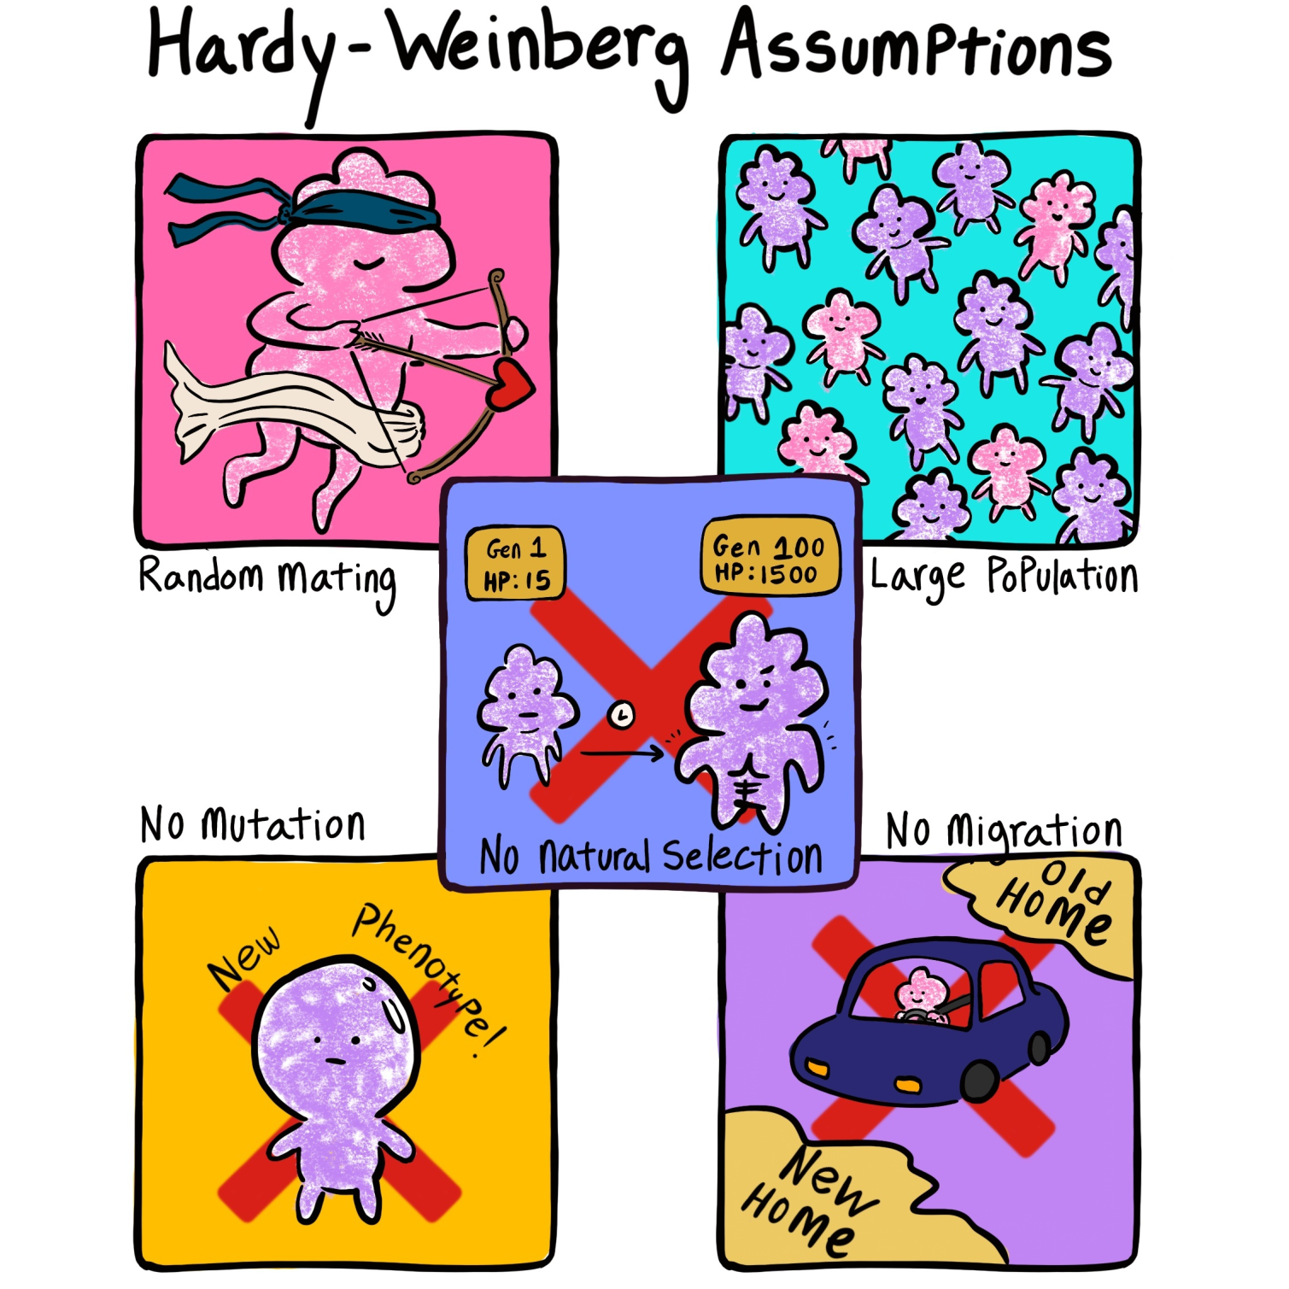

Slide 17
Reality?
If all of these conditions are met, and the allele frequencies are not changing between generations, then the population is in Hardy-Weinberg equilibrium and is not evolving.
In nature, one or more of these assumptions is always being violated. Real, natural populations are compared against the Hardy-Weinberg model to see if they are evolving.

Slide 18
How Do We Calculate Hardy-Weinberg Equilibrium?
There are two important equations in Hardy-Weinberg calculations. When there are two alleles for a trait in a population, we know that:
p+q=1
Here, p is the frequency of the dominant allele and q is the frequency of the recessive allele. Together, the two frequencies must add up to 1 (100 percent of the population).

Slide 19
How Do We Calculate Hardy-Weinberg Equilibrium?
Each organism has two copies of every gene per trait, so allele frequencies are doubled for genotype frequencies.
Because of this, genotype frequencies for a population at Hardy-Weinberg proportions can be calculated by squaring the previous equation:
(p+q=1) ²
p²+2pq+q²=1

Slide 20
How Do We Calculate Hardy-Weinberg Equilibrium?
Again, p is the frequency of the dominant allele and q is the frequency of the recessive allele.
→ p² is the frequency of the homozygous dominant genotype.
→ q² is the frequency of the homozygous recessive genotype.
→ 2pq is the frequency of the heterozygous genotype.

Slide 21
Example
Sickle-cell anemia is an interesting genetic disease:
Normal homozygous individuals (SS) have normal blood cells that are easily infected with the malarial parasite. Thus, many of these individuals become very ill from the parasite and many die.
Individuals homozygous for the sickle-cell trait (ss) have red blood cells that readily collapse when deoxygenated. Although malaria cannot grow in these red blood cells, individuals often die because of the genetic defect.
However, individuals with the heterozygous condition (Ss) have some sickling of red blood cells, but generally not enough to cause mortality. In addition, malaria cannot survive well within these "partially defective" red blood cells. Thus, heterozygotes tend to survive better than either of the homozygous conditions.

Slide 22
Example
If 9% of an African population is born with a severe form of sickle-cell anemia (ss), what percentage of the population will be more resistant to malaria because they are heterozygous (Ss) for the sickle-cell gene?
ANS
9% =0.09 = ss = q².
To find q, simply take the square root of 0.09 to get 0.3.
Since p = 1 - 0.3, then p must equal 0.7.
2pq = 2 (0.7 x 0.3) = 0.42 = 42% of the population are heterozygotes (carriers).

Slide 23
More examples?
https://www.k-state.edu/parasitology/biology198/hardwein.html

